Slide 1
Hierarchies
Hierarchies

Slide 2
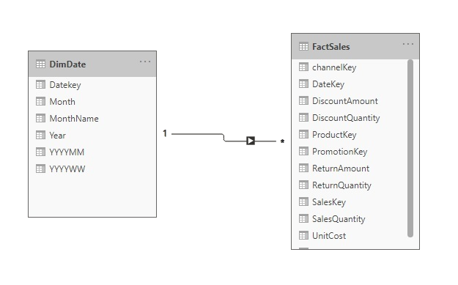
Hierarchies
Note: This Lab uses the Sales.xslx file located in the resources\Excel Source folder
Navigate to the location of the SalesExcel.xslx file and load both tables DimDate and FactSales at the query editor level
Check that the relationship is well established between DimDate and FactSales

Slide 3
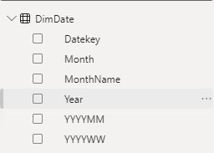
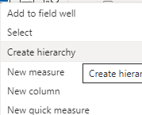
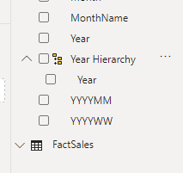
Hierarchies
Select Year and right click mouse, then apply Create Hierarchy
Notice the presence of a new field with a Year element in it

Slide 4
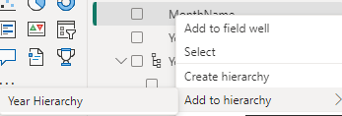
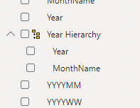
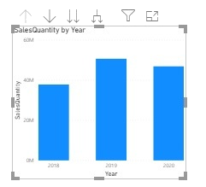
Hierarchies
Add MonthName in just under Year, by right clicking it and adding it to Year hierarchy
Add a Clustered column visual drag the newly created hierarchy to the X-Axis as well as Sales Quantity from the FactSales table to the Y-Axis
Try exploring the navigation capabilities offered represented by these icons

Slide 5
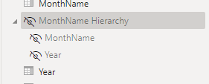
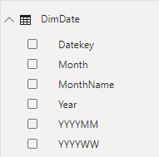
Hierarchies
Right click on the hierarchy and click Hide from report view notice that the hierarchy is no longer visible in the visual interface

Slide 6
Thank you
Thank you

